Slide 1
Problem reduction
Ram Krishna Dahal
Asst. Professor
Central Department of computer science and IT, TU

Slide 2
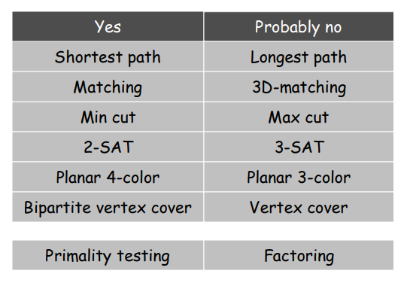
Those with polynomial-time algorithms

Slide 3
Classify Problems
Classify problems according to those that can be solved in polynomial-time and those that cannot.
Provably requires exponential-time.
Given a Turing machine, does it halt in at most k steps?
Given a board position in an n-by-n generalization of chess, can black guarantee a win?

Slide 4

Polynomial-Time Reduction
Problem X polynomial-time reduces to problem Y if arbitrary instances of problem X can be solved using:
Polynomial number of standard computational steps, plus
Polynomial number of calls to oracle that solves problem Y.
Notation: $X≤_{p}Y$
Means we can solve X in polynomial time IF we can solve Y in polynomial time!

Slide 5

Polynomial-Time Reduction
Purpose: Classify problems according to relative difficulty.
Design algorithms: If $X≤_{p}Y$ and Y can be solved in polynomial-time, then X can also be solved in polynomial time.
Establish intractability: If $X≤_{p}Y$ and X cannot be solved in polynomial-time, then Y cannot be solved in polynomial time.
Establish equivalence: If $X≤_{p}Y$ and $Y≤_{p}X$ , we use notation $X{\overline{=}}_{p}Y$ .

Slide 6
reduction strategies
Basic reduction strategies
Reduction by simple equivalence
Reduction from special case to general case
Reduction by encoding with gadgets.

Slide 7
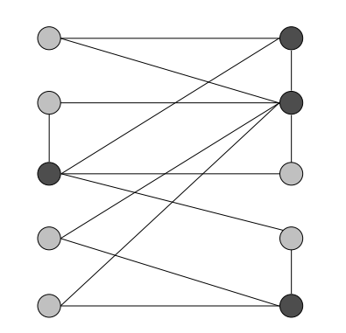

Vertex Cover
Given a graph G = (V, E) and an integer k, is there a subset of vertices S $⊆$ V such that |S| $≤$ k, and for each edge, at least one of its endpoints is in S?
Ex. Is there a vertex cover of size $≤$ 4? Yes.
Ex. Is there a vertex cover of size $≤$ 3? No.

Slide 8

Independent Set
Given a graph G = (V, E) and an integer k, is there a subset of vertices S $⊆$ V such that |S| $≥$ k, and for each edge at most one of its endpoints is in S?
Ex. Is there an independent set of size $≥$ 6? Yes.
Ex. Is there an independent set of size $≥$ 7? No.

Slide 10

Reduction by simple equivalence
Claim: VERTEX-COVER ${\overline{=}}_{p}$ INDEPENDENT-SET
Pf. : We show S is an independent set iff V - S is a vertex cover

Slide 11
Hamiltonian Cycle
A cycle in an undirected graph G =(V, E) which traverses every vertex exactly once.
given an undirected graph G = (V, E), does there exist a simple cycle that contains every node in V.
Problem Statement: Given a graph G(V, E), the problem is to determine if the graph contains a Hamiltonian cycle consisting of all the vertices belonging to V.

Slide 12
The Satisfiability Problem (SAT )
Boolean Satisfiability or simply SAT is the problem of determining if a Boolean formula is satisfiable or unsatisfiable.
Study of Boolean functions generally is concerned with the set of truth assignments (assignments of 0 or 1 to each of the variables) that make the function true.
NP-completeness needs only a simpler question (SAT): does there exist a truth assignment making the function true?

Slide 13
Example: SAT
(x+y)(-x + -y) is satisfiable.
There are, in fact, two satisfying truth assignments:
1. x=0; y=1.
2. x=1; y=0.
x(-x) is not satisfiable.

Slide 14
3SAT
It is not true that every Boolean formula can be converted to an equivalent 3-CNF formula, even if we exponentiate the size of the formula
This problem is NP-complete.
Clearly it is in NP, since SAT is

Slide 15
Clique
A clique is a subgraph of a graph such that all the vertices in this subgraph are connected with each other that is the subgraph is a complete graph.
The Maximal Clique Problem is to find the maximum sized clique of a given graph G, that is a complete graph which is a subgraph of G and contains the maximum number of vertices.
This is an optimization problem. Correspondingly, the Clique Decision Problem is to find if a clique of size k exists in the given graph or not.

Slide 16
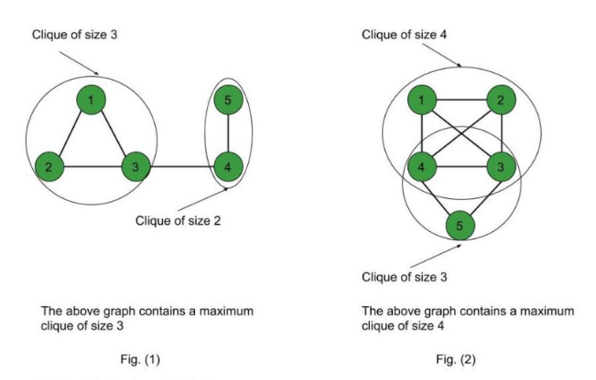

Slide 17
Travelling Salesman Problem (tsp)
Given a set of cities and distance between every pair of cities, the problem is to find the shortest possible route that visits every city exactly once and returns to the starting point.
Note the difference between Hamiltonian Cycle and TSP. The Hamiltoninan cycle problem is to find if there exist a tour that visits every city exactly once. Here we know that Hamiltonian Tour exists (because the graph is complete) and in fact many such tours exist, the problem is to find a minimum weight Hamiltonian Cycle.

Slide 18
Tsp is np complete
Given a set of cities and the distance between each pair of cities, the travelling salesman problem finds the path between these cities such that it is the shortest path and traverses every city once, returning back to the starting point.
Problem – Given a graph G(V, E), the problem is to determine if the graph has a TSP consisting of cost at most K.

Slide 19
Subset Sum
Given a (multi)set A of integer numbers and an integer number s, does there exist a subset of A such that the sum of its elements is equal to s?

